Slide 1
Financial Accounting
IFRS 5th Edition
Weygandt ● Kimmel
Chapter 8
Accounting for Receivables
This slide deck contains animations. Please disable animations if they cause issues with your device.
Copyright © John Wiley & Sons, Inc.
Notes:
AR → company allow customer to pay later, then company will have AR … right to receive cash later

Slide 2
Chapter Outline
Learning Objectives
LO 1 Explain how companies recognize accounts receivable.
LO 2 Describe how companies value accounts receivable and record their disposition.
LO 3 Explain how companies recognize, value, and dispose of notes receivable.
LO 4 Describe the statement presentation and analysis of receivables.

Slide 3
Learning Objective 1 Explain How Companies Recognize Accounts Receivable.
L O 1

Slide 4
Receivables
The term receivables refers to amounts due from individuals and companies.
Receivables are claims that are expected to be collected in cash.
Management of receivables is a very important activity for any company that sells goods or services on credit.
Receivables represent one of a company’s most liquid assets.
L O 1
Notes:
What is most liquid asset? Cash
Receivable → Converted into cash … so are very liquid too.

Slide 5
Receivables by Company
Receivables as a percentage of total assets for five well-known companies in a recent year
Company | Receivables as a Percentage of Total Assets
adidas (DEU) | 9%
Hyundai (KOR) | 3
Samsung (KOR) | 9
Nestlé (CHE) | 9
China Mobile Limited (HKG) | 5
Illustration 8.1: Receivables as a percentage of assets
L O 1

Slide 6
Types of Receivables
Amounts due from individuals and companies that are expected to be collected in cash.
Amounts customers owe on account that result from the sale of goods and services.
Written promise (formal instrument) for amounts to be received. Normally requires the collection of interest.
Nontrade receivables such as interest, loans to officers, advances to employees, and income taxes refundable.
Accounts Receivable
Notes Receivable
Other Receivables
L O 1
Notes:
Notes → sometimes if company lend money, it will also result in notes receivable.

Slide 7
Recognizing Accounts Receivable
Service organization records a receivable when it performs service on account.
Merchandiser records accounts receivable at the point of sale of merchandise on account.
Seller may offer a discount to encourage early payment
Buyer may return goods found to be unacceptable
Sales returns reduce receivables
L O 1
Notes:
In ch5 → covered merchandising companies & credit sales … for credit sales record service rev & AR…

Slide 8
Accounts Receivable Example
Illustration: Assume that Zhang Ltd. on July 1, 2025, sells merchandise on account to Li Stores for ¥1,000, terms 2/10, n/30 (amounts in thousands). On July 5, Li returns merchandise with a sales price of ¥100 to Zhang. Prepare the journal entries to record these transactions.
Jul. 1
Accounts Receivable 1,000
Sales Revenue 1,000
Jul. 5
Sales Returns and Allowances 100
Accounts Receivable 100
L O 1
Notes:
2/10, net 30 → if customer pay within 10 day, enjoy 2 % discount. Otherwise, pay full amount in 30 days Last period of discount period → 7/11.
If return on 7/5, then decrease AR and debit sales return … sales return (contra-revenue account)
In periodic, no COGS

Slide 9
Account Receivable – Payment
Illustration: On July 11, Zhang receives payment from Li for the balance due. Prepare the journal entry to record this transaction.
Jul. 11
Cash (¥900 − ¥18) 882
Sales Discounts (¥900 x .02) 18
Accounts Receivable 900
L O 1
Notes:
Focus on whether customer can enjoy discount… pay on 7/11 so can enjoy discount.
Return goods is 100 → so only need to pay 900… then discount is 2% of 900.

Slide 10
DO IT! 1: Recognizing Accounts Receivable
On May 1, Wilton sold merchandise on account to Bates for £50,000, terms 3/15, net 45. On May 4, Bates returns merchandise with a sales price of £2,000. On May 16, Wilton receives payment from Bates for the balance due. Prepare journal entries to record the May transactions on Wilton’s books. (Ignore cost of goods sold entries.)
(Term 3/15, Net 45: the customer can take a 3% discount if payment is made within 15 days, or the full amount is due after 45 days.)
L O 1

Slide 11
DO IT! 1: Recognizing Accounts Receivable – Solution
Accounts Receivable 50,000
Sales Revenue 50,000
May 1
May 4
Sales Returns and Allowances 2,000
Accounts Receivable 2,000
May 16
Cash (£48,000 − £1,440) 46,560
Sales Discounts (£48,000 × .03) 1,440
Accounts Receivable 48,000
L O 1

Slide 12
Learning Objective 2 Describe How Companies Value Accounts Receivable and Record Their Disposition.
L O 2

Slide 13
Valuing Accounts Receivable
Reported as a current asset
Valued at net realizable value (->total amount of money an asset might generate upon its sale, less a reasonable estimate of the costs, fees, and taxes associated with that sale or disposal)
Uncollectible Accounts Receivable
Sales on account raise possibility of accounts not being collected
Seller records losses that result from extending credit as Bad Debt Expense (or Uncollectible Accounts Expense)
L O 2
Notes:
Value of AR → can we 100% collect cash? No. Sometimes we cannot collect.
Company is bearing risk of not being able to collect.
NRV of AR → amount of cash that we expect to collect
Because of uncollectible amounts, we have some risk that we may be unable to collect cash.

Slide 14
Accounting for Uncollectible Accounts
Allowance Method
Estimate uncollectible accounts at the end of each period
Better matching of expenses with revenues
Receivables stated at cash (net) realizable value
Required for financial reporting purposes
L O 2

Slide 15
Allowance Method for Uncollectible Accounts
Companies estimate uncollectible accounts receivable at the end of each period.
During the year, write off actual bad debts as uncollectible. Actual write off may be different than estimate.
At the end of the year, estimate future uncollectible amounts. Adjust the Allowance for Doubtful Accounts to the estimated amount
(DR) Bad Debt Expense
(CR) Allowance for Doubtful Accounts (contra-asset)
(DR) Allowance of Doubtful Accounts
(CR) Accounts Receivable
L O 2

Slide 16

Account receivables
Recognize the cost before it actually went bad (Conservatism)
bad debt expense (Dr)
Allowance for Doubtful Accounts
(CR)
Estimated uncollectible
written off
Become uncollectible

Slide 17
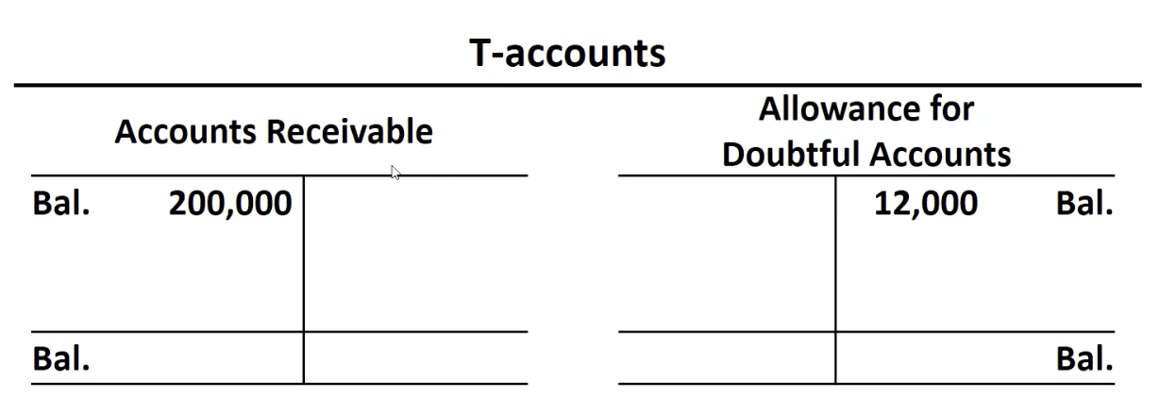
T-Accounts
Allowance for doubtful accounts
Contra-asset account
Created to recognize the allowance for uncollectible accounts
Notes:
Out of 200,000 AR → 12,000 is estimated to be uncollectible.
Increase in allowance, reduces NRV of AR.

Slide 18
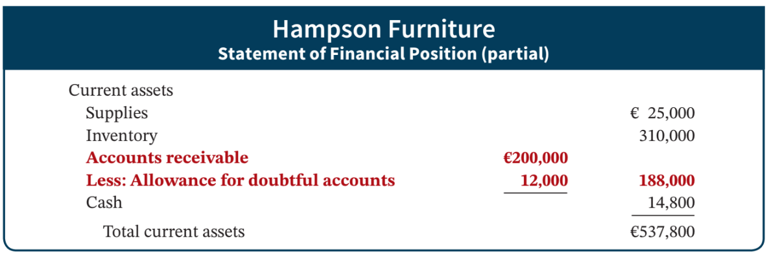
Allowance Method – Presentation
net realizable value
Illustration 8.3: Presentation of allowance for doubtful accounts
L O 2
Notes:
AR & contra-asset account (allowance) are both shown. WE only expect 188,000 to be able to collect … this is the NRV of AR

Slide 19
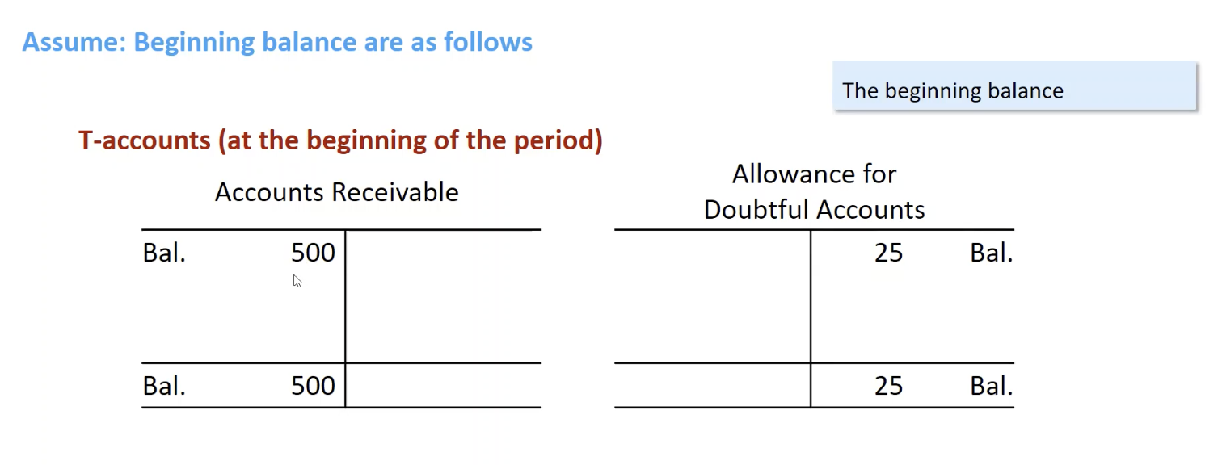
Illustration (1)
Notes:
Beginning balance
AR 500 → means 500 is not yet collected
Allowance 25 → out of 500, 25 is estimated to be uncollectible

Slide 20
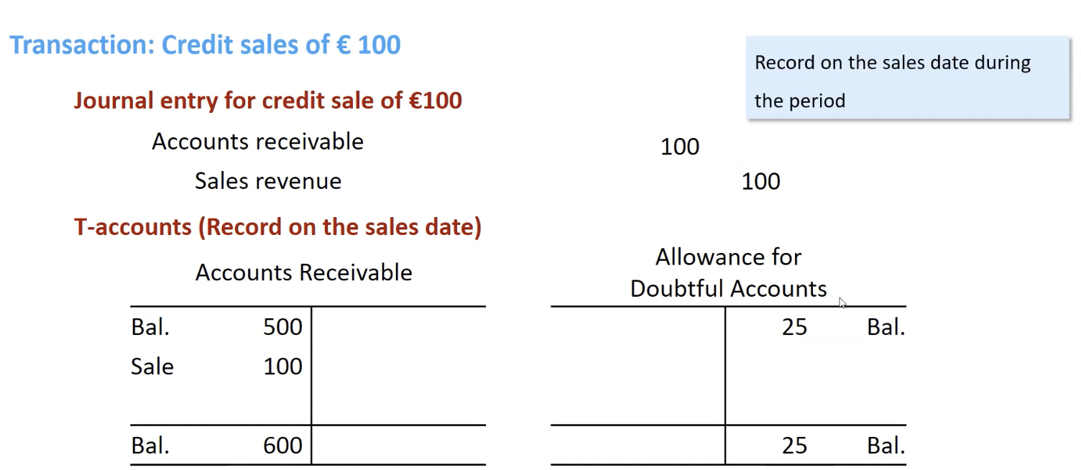
Illustration (2)
Notes:
During period, company has credit sale of 100. What is effect?
AR goes up … balance is 600 now.
What about allowance? No change.

Slide 21
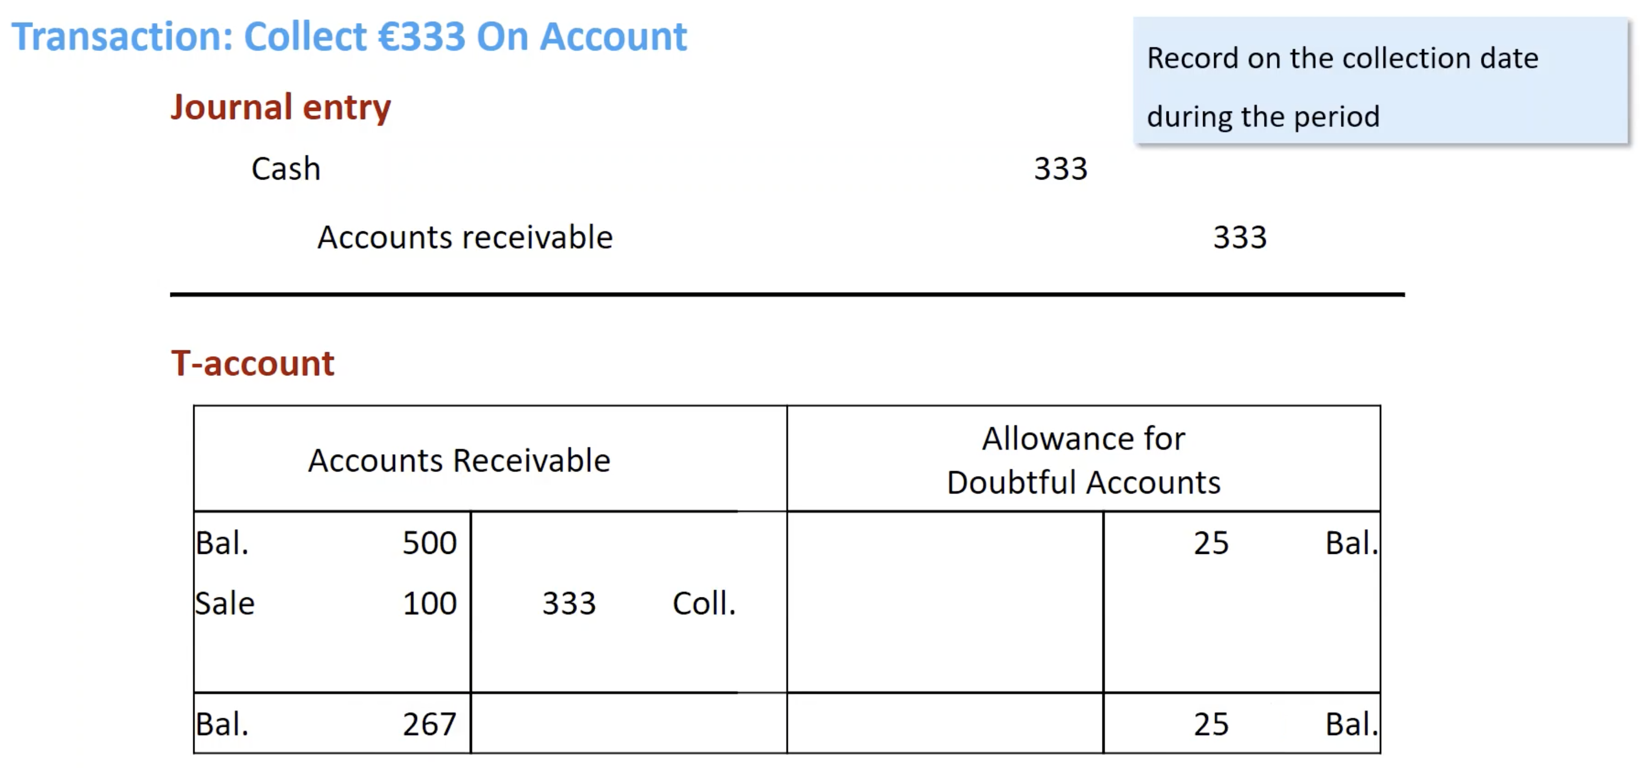
Illustration (3)
Notes:
Collect 300…
AR goes down by 300.
Allowance no change

Slide 22
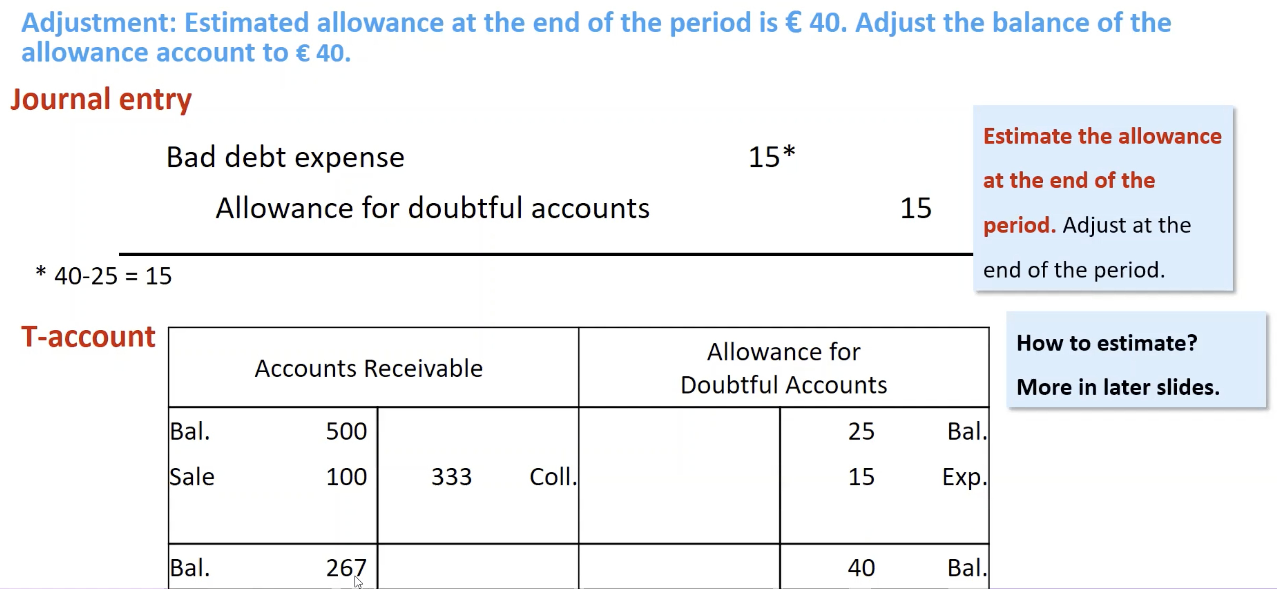
Illustration (4)
Notes:
At end of period, we estimate allowance at end of period.
Estimated amount is 40.
Out of 267, we expect 40 to be uncollectible. 40 is ending balance by estimation.
Update the balance of allowance to be 40 … we credit by 15.
Journal entry is adjusting entry.

Slide 23
Recording the Write-Off
A write-off affects only statement of financial position accounts.
It reduces both Accounts Receivable and Allowance for Doubtful Accounts.
Cash realizable value remains the same.
L O 2

Slide 24
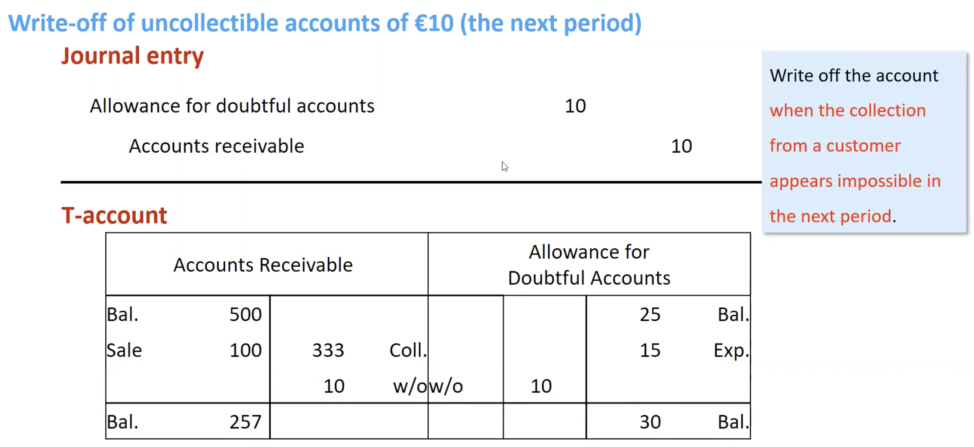
Illustration (5)
Notes:
Write off example. Preivously, by estimation 40 is uncollectible.
Now we know 10 is going to be uncollected.
Remaining 30 is expected to be uncollectible.

Slide 25
Allowance Method for Uncollectibles
Recording Estimated Uncollectibles
Illustration: Hampson Furniture has credit sales of €1,200,000 in 2025, of which €200,000 remains uncollected at December 31. The credit manager estimates that €12,000 of these receivables will be uncollectible.
Dec. 31
Bad Debt Expense 12,000
Allowance for Doubtful Accounts 12,000
L O 2

Slide 26
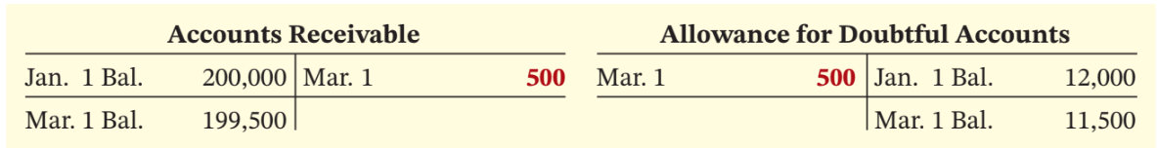
Write-off Example
Illustration: The financial vice president of Hampson Furniture authorizes a write-off of the €500 balance owed by R.A. Ware on March 1, 2026. The entry to record the write-off is as follows.
Mar. 1
Allowance for Doubtful Accounts 500
Accounts Receivable 500
Illustration 8.4: General ledger balances after write-off
L O 2

Slide 27
Cash Realizable Value
A write-off affects only statement of financial position accounts—not income statement accounts.
The write-off of the account reduces both Accounts Receivable and Allowance for Doubtful Accounts.
Cash realizable value in the statement of financial position, therefore, remains the same.
 | Before Write-Off | After Write-Off
Accounts receivable | €200,000 | €199,500
Allowance for doubtful accounts | 12,000 | 11,500
Cash realizable value | €188,000 | €188,000
Illustration 8.5: Cash realizable value comparison
L O 2

Slide 28
Recovery of an Uncollectible Account (Not very common)
Illustration: On July 1, R.A. Ware pays the €500 amount that Hampson had written off on March 1. Hampson makes the following entries.
July 1
Accounts Receivable 500
Allowance for Doubtful Accounts 500
July 1
Cash 500
Accounts Receivable 500
L O 2

Slide 29
Estimating the Allowance
Given say we have $1M account receivable, how much do I want to make it allowance for doubtful account? (i.e., how much do I want my water tank to reserve water for future write off)
account receivable
allowance for doubtful account
L O 2

Slide 30
Estimating the Allowance
Frequently, companies estimate the allowance as a percentage of the outstanding receivables.
Percentage-of-Receivables Basis
Step 1
Management establishes a percentage relationship between amount of receivables and expected losses from uncollectible accounts
L O 2

Slide 31
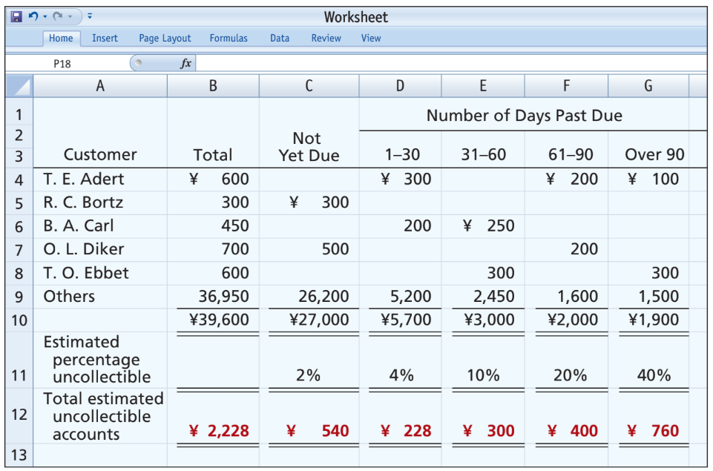
Estimating the Allowance – Aging
Illustration 8.7: Aging schedule
L O 2

Slide 32
Estimating the Allowance
Frequently, companies estimate the allowance as a percentage of the outstanding receivables.
Percentage-of-Receivables Basis
Step 2： recording bad debt expense
Amount of bad debt expense that should be recorded is the difference between the required balance and the existing balance in the allowance account
L O 2

Slide 33
Case 1.
required balance of the allowance account = existing balance of the allowance account
You don’t have to do anything.
L O 2

Slide 34
Estimating the Allowance – Aging
Illustration 8.7: Aging schedule
L O 2

Slide 35

Case 2. (Most often)
required balance (i.e.,2228)> existing balance in the allowance account (i.e., say 528)
required balance
existing balance
L O 2

Slide 36
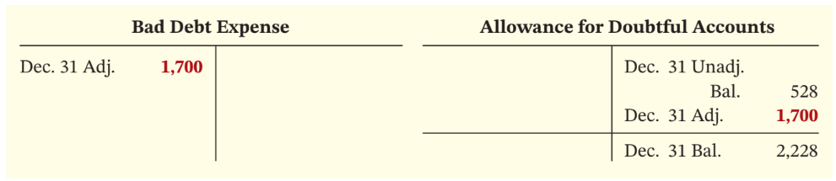
Estimating the Allowance Example
Illustration: The unadjusted trial balance shows Allowance for Doubtful Accounts with a credit balance of ¥528. Prepare the adjusting entry assuming ¥2,228 is the estimate of uncollectible receivables from the aging schedule.
Dec. 31
Bad Debt Expense 1,700
Allowance for Doubtful Accounts 1,700
Illustration 8.8: Bad debt accounts after posting
L O 2

Slide 37
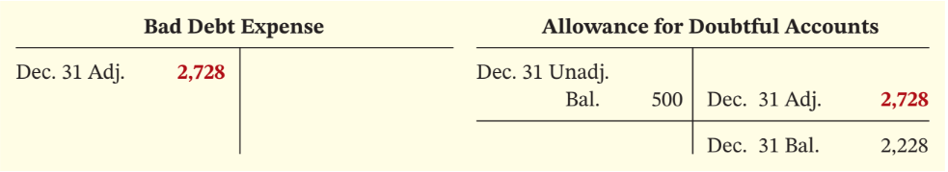
Bad Debts after Posting
Illustration: Assume the unadjusted trial balance shows Allowance for Doubtful Accounts with a debit balance of ¥500. Prepare the adjusting entry assuming ¥2,228 is the estimate of uncollectible receivables.
Dec. 31
Bad Debt Expense 2,728
Allowance for Doubtful Accounts 2,728
Illustration 8.9: Bad debt accounts after posting
L O 2

Slide 38
Case 3. (Less often)
required balance < existing balance in the allowance account
You are overly conservative. Do need to do anything. Just wait for future write offs.
existing balance
required balance
L O 2

Slide 39
DO IT! 2a: Bad Debt Expense
Brule Group has been in business for 5 years. The unadjusted trial balance at the end of the current year shows Accounts Receivable $30,000, Sales Revenue $180,000, and Allowance for Doubtful Accounts with a debit balance of $2,000. Brule estimates bad debts to be 10% of accounts receivable. Prepare the entry necessary to adjust Allowance for Doubtful Accounts.
L O 2

Slide 40
DO IT! 2a: Bad Debt Expense – Solution
Brule Group has been in business for 5 years. The unadjusted trial balance at the end of the current year shows Accounts Receivable $30,000, Sales Revenue $180,000, and Allowance for Doubtful Accounts with a debit balance of $2,000. Brule estimates bad debts to be 10% of accounts receivable. Prepare the entry necessary to adjust Allowance for Doubtful Accounts.
Bad Debt Expense 5,000*
Allowance for Doubtful Accounts 5,000
* [(10% × $30,000) + $2,000]
L O 2

Slide 41
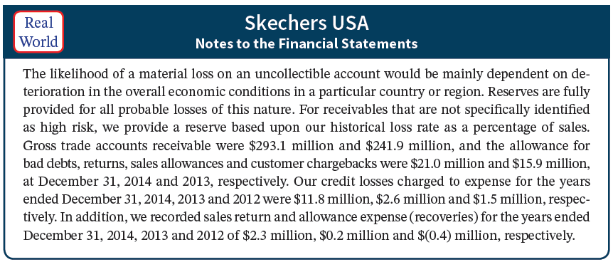
Accounts Receivable Note Disclosure
Illustration 8.10: Skechers USA’s note disclosure of accounts receivable
L O 2

Slide 42
Allowance for doubtful accounts and earnings management
Illustration 8.10: Skechers USA’s note disclosure of accounts receivable
L O 2

Slide 43
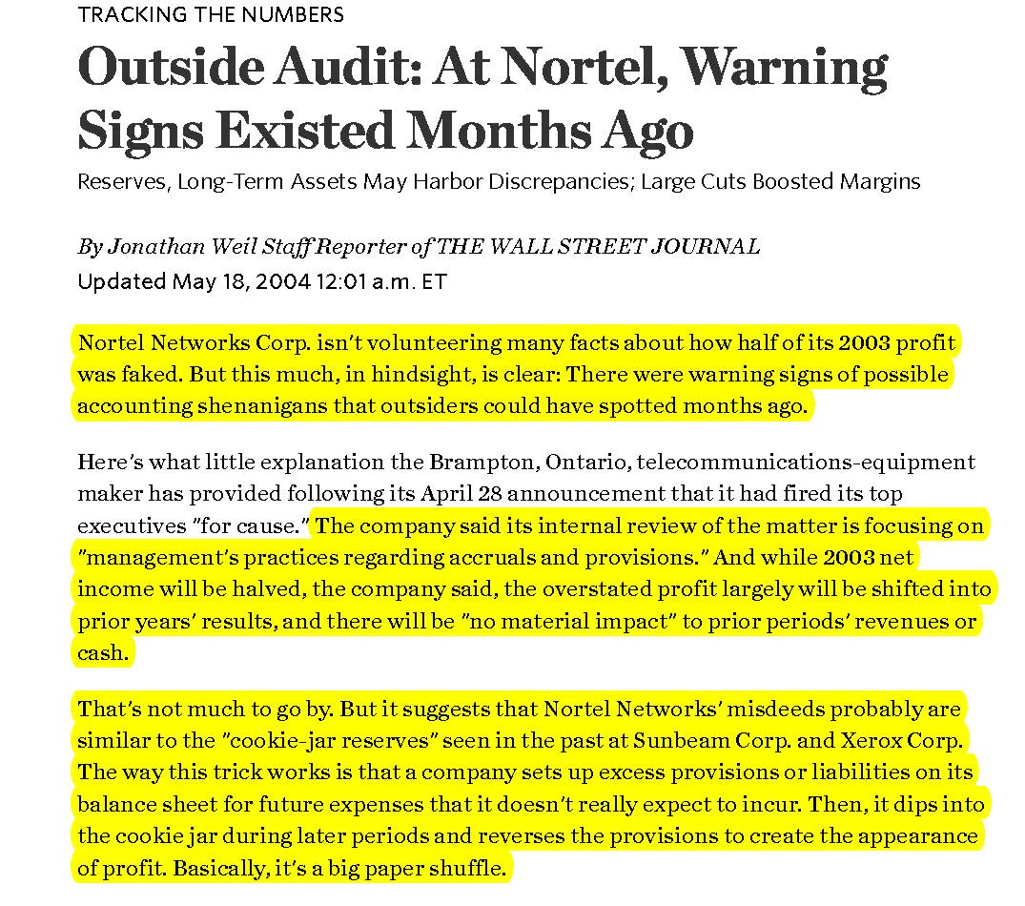
Example: Nortel Networks

Slide 44
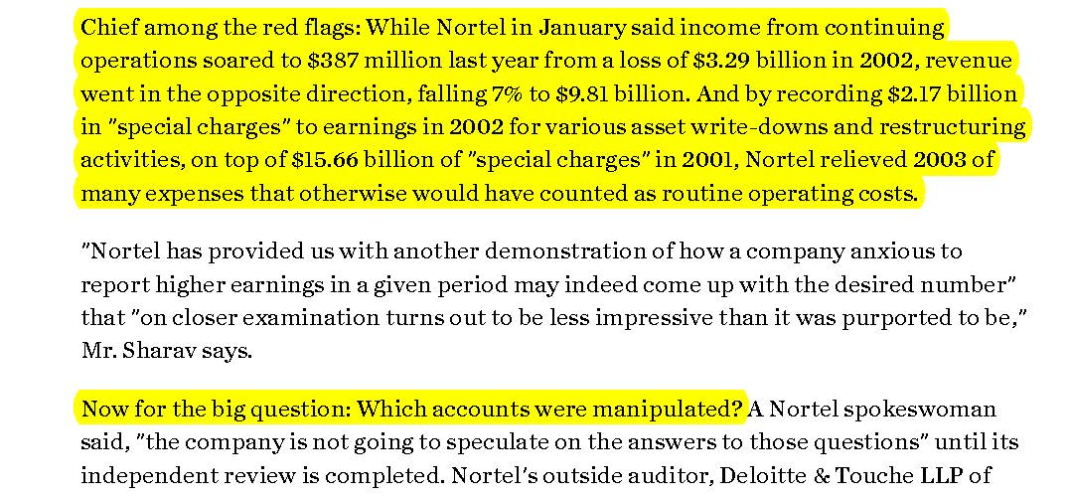
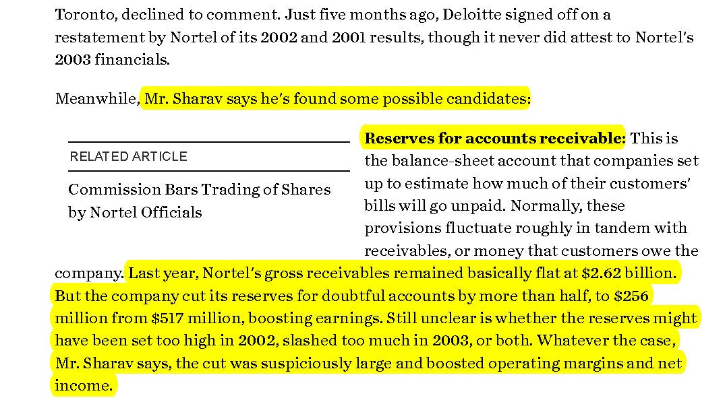
Example: Nortel Networks

Slide 45
Excerpts From Nortel Networks’ Income Statements

Slide 46
Excerpts From Nortel Networks’ Income Statements

Slide 47
Excerpts From Nortel Networks’ Balance Sheets
Did not incur bad debt expense to supplement allowance for bad debt

Slide 48
Example: Nortel Networks

Slide 49
Review of bad debt expanse
At the end of the current year, managers of ABC company find that the unadjusted trial balance shows Accounts Receivable $10,000, and Allowance for Doubtful Accounts with a credit balance of $1,000. ABC company estimates bad debts to be 20% of accounts receivable. Prepare the entry necessary to adjust Allowance for Doubtful Accounts.
L O 2

Slide 50
Review of bad debt expanse
At the end of the current year, managers of ABC company find that the unadjusted trial balance shows Accounts Receivable $10,000, and Allowance for Doubtful Accounts with a credit balance of $1,000. ABC company estimates bad debts to be 20% of accounts receivable. Prepare the entry necessary to adjust Allowance for Doubtful Accounts.
Bad Debt Expense 1,000*
Allowance for Doubtful Accounts 1,000
Required allowance = 20% × $10,000
Existing allowance = $1,000; bad debt expense = 2000-1000=1000
L O 2

Slide 51
Disposing (Selling) of Accounts Receivable
L O 2

Slide 52
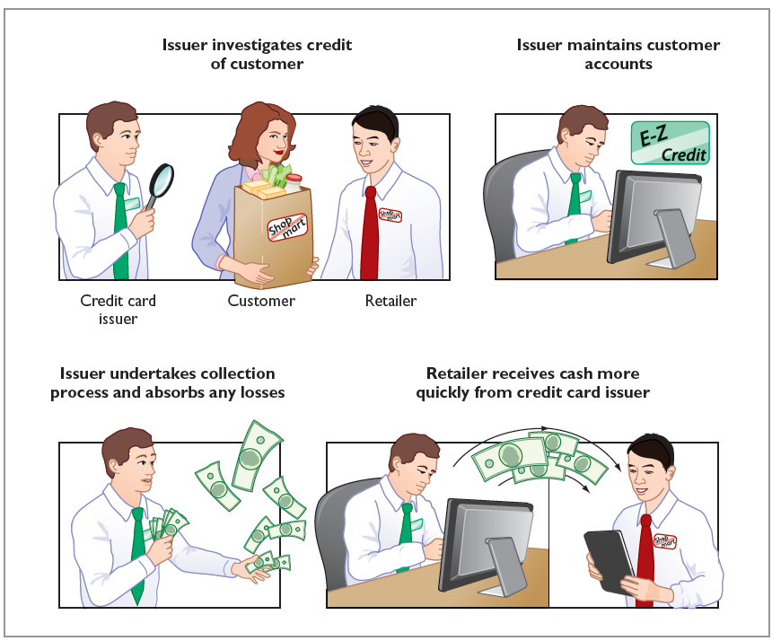

Disposing of account receivables
Products
Account receivables
Cash, with a fee
Cash later
Account receivables

Slide 53
Sale of Receivables to a Factor
A factor is a finance company or bank.
Buys receivables from businesses and then collects payments directly from customers.
Typically charges a commission to the company that is selling receivables.
Fee often ranges from 1% to 3% of receivables purchased.
L O 2

Slide 54
Disposing of Accounts Receivable
Companies sell receivables for two major reasons:
Receivables may be the only reasonable source of cash.
Billing and collection are often time-consuming and costly.
The most significant advantage of a factoring line is that it solves cash flow problems created by slow-paying invoices.
L O 2

Slide 55


Slide 56
Sale of Receivables to a Factor Example
Illustration: Assume that Keelung Jewelry factors NT$600,000 of receivables to Federal Factors (amounts in thousands). Federal Factors assesses a service charge of 2% of the amount of receivables sold. The journal entry to record the sale by Keelung Jewelry is as follows.
Cash 588,000
Service Charge Expense 12,000*
Accounts Receivable 600,000
*(NT$600,000 × 2% = NT$12,000)
L O 2

Slide 57
National Credit Card Sales
Retailer’s acceptance of credit cards is another form of selling (factoring) receivables
Retailer pays card issuer (i.e., bank) a fee of 2 to 4% of invoice price
Records credit card sales as cash sales
Advantages to retailer:
Issuer investigates credit of customer
Issuer maintains customer accounts
Issuer undertakes collection process and absorbs losses
Receives cash more quickly
L O 2

Slide 58
Advantages of National Credit Card
Sell products
Pay cash to retailer, charge a fee
Pay cash to card issuer later
Card issuer: I hold account receivables
Illustration 8.11: Advantages of credit cards to the retailer
L O 2

Slide 59
National Credit Card Sales Example
Illustration: Ling Lee purchases NT$6,000 of paper products for her restaurant from Wu Supplies using her Visa First Bank Card. First Bank charges a service fee of 3%. The entry to record this transaction by Wu Supplies on March 22, 2025, is as follows.
Cash 5,820
Service Charge Expense 180*
Sales Revenue 6,000
*(NT$6,000 × 3% = NT$180)
L O 2

Slide 60
DO IT! 2b: Factoring
Kell Wholesalers needs to raise €120,000 in cash to safely cover next Friday’s employee payroll. Kell has reached its debt ceiling. Kell’s present balance of outstanding receivables totals €750,000. Kell decides to factor €125,000 of its receivables on September 7, 2025, to alleviate this cash crunch. Record the entry that Kell would make when it raises the needed cash. (Assume a 1% service charge.)
L O 2

Slide 61
DO IT! 2b: Factoring – Solution
Cash 123,750
Service Charge Expense 1,250*
Accounts Receivable 125,000
*(€125,000 × 1% = €1,250)
L O 2

Slide 62
Learning Objective 3 Explain How Companies Recognize, Value, and Dispose of Notes Receivable.
L O 3

Slide 63
Promissory Note
Companies may grant credit in exchange for a promissory note. A promissory note is a written promise to pay a specified amount of money on demand or at a definite time.
Promissory notes may be used
when individuals and companies lend or borrow money
when the amount of the transaction and credit period exceed normal limits
in settlement of accounts receivable.
L O 3

Slide 64
Advantages of National Credit Card
Sell products for 100
account receivables due in 30 days
After 30 days
I don’t have money, can I pay you later?
OK, I will grant you a promissory note, with face value 100 and interest rate 2%, and due in 1 year
L O 2

Slide 65
Promissory Note Parties
To the payee, the promissory note is a note receivable.
To the maker, the promissory note is a note payable.
Illustration 8.12: Promissory note
L O 3

Slide 66
Determining the Maturity Date
Maturity date of a promissory note may be stated in one of three ways:
On demand.
On a stated date.
At the end of a stated period of time.
Note terms are expressed in:
Months
Days
L O 3

Slide 67
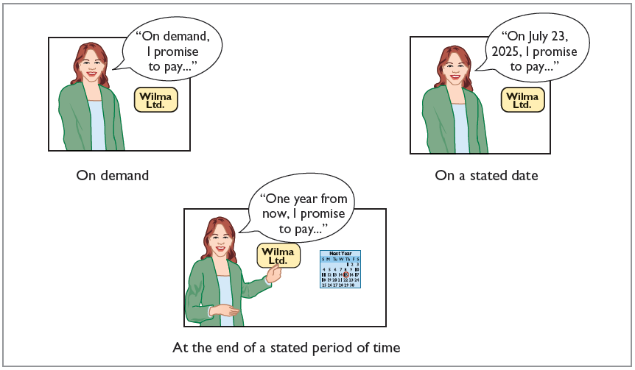
Three Ways of Stating Maturity Date
Illustration 8.13: Maturity date of different notes
L O 3

Slide 68
Computing Interest
Face value of Note | × | Annual Interest Rate | × | Time in Terms of One year | = | Interest
Illustration 8.15: Formula for computing interest
When counting days, omit date note is issued, but include due date
Terms of Note |  | Interest Computation
 |  |  |  | Face | x | Rate | x | Time | = | Interest
₺ 730, | 12%, | 120 days |  | ₺ 730 | x | 12% | x | 120/360 | = | ₺ 29.20
₺1,000, | 9%, | 6 months |  | ₺1,000 | x | 9% | x | 6/12 | = | ₺ 45.00
₺2,000, | 6%, | 1 year |  | ₺2,000 | x | 6% | x | 1/1 | = | ₺120.00
Illustration 8.16: Computation of interest
L O 3

Slide 69
Recognizing Notes Receivable
Illustration: Calhoun plc wrote a £1,000, two-month, 12% promissory note dated May 1, to settle an open account. Prepare an entry Wilma Ltd. would make for the receipt of the note.
May 1
Notes Receivable 1,000
Accounts Receivable 1,000
L O 3

Slide 70
Valuing Notes Receivable
Report short-term notes receivable at their cash (net) realizable value.
Estimations involved in determining cash realizable value and in recording bad debt expense and the related allowance are similar to those for accounts receivable.
L O 3

Slide 71
Disposing of Notes Receivable
Notes may be held to their maturity date; at which time the face value plus, accrued interest is due.
Maker may default and payee must make an adjustment to the account.
Like selling account receivables, holder can speed up conversion to cash by selling the note receivable.
L O 3

Slide 72
Honoring Notes Receivable
Honor of Notes Receivable
Maker pays it in full at its maturity date
Dishonor of Notes Receivable
Not paid in full at maturity
Holder still has a claim against the maker of the note
Holder transfers the Notes Receivable to an Accounts Receivable account
L O 3

Slide 73
Honor of Notes Receivable
Illustration: Wolder Co. lends Higley Co. €10,000 on June 1, accepting a five-month, 9% interest note. To obtain payment, Wolder (the payee) must present the note either to Higley Co. (the maker) or to the maker’s agent, such as a bank. If Wolder presents the note to Higley Co. on November 1, the maturity date, Wolder’s entry to record the collection is as follows.
Nov. 1
Cash 10,375
Notes Receivable 10,000
Interest Revenue 375
L O 3

Slide 74
Notes Receivable Review Question
Accounts and notes receivable are reported in the current assets section of the statement of financial position at:
cash (net) realizable value.
net book value.
lower-of-cost-or-net realizable value.
invoice cost.
L O 3

Slide 75
Notes Receivable – Solution
Accounts and notes receivable are reported in the current assets section of the statement of financial position at:
cash (net) realizable value. (Correct)
net book value.
lower-of-cost-or-net realizable value.
invoice cost.
L O 3

Slide 76
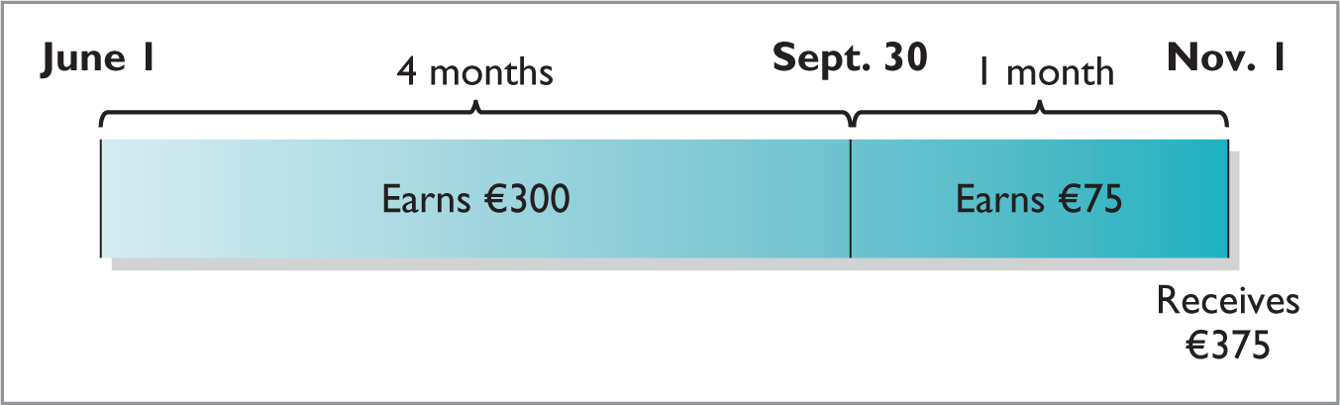
Accrual of Interest Receivable (1 of 2)
Illustration: Suppose instead that Wolder Co. prepares financial statements as of September 30. The adjusting entry by Wolder is for four months ending Sept. 30.
Interest Receivable 300
Interest Revenue 300
Sept. 30
Illustration 8.17: Timeline of interest earned
L O 3

Slide 77
Accrual of Interest Receivable (2 of 2)
Illustration: Prepare the entry Wolder would make to record the honoring of the Higley note on November 1.
Nov. 1
Cash 10,375
Notes Receivable 10,000
Interest Receivable 300
Interest Revenue 75
L O 3

Slide 78
Dishonor of Notes Receivable (1 of 2)
Illustration: Assume that Higley Co. on November 1 indicates that it cannot pay at the present time. If it does expect eventual collection, Wolder Co. would make the following entry at the time the note is dishonored (assuming no previous accrual of interest).
Nov. 1
Accounts Receivable 10,375
Notes Receivable 10,000
Interest Revenue 375
L O 3

Slide 79
Dishonor of Notes Receivable (2 of 2)
Illustration: If instead on November 1 there is no hope of collection, the note holder would write off the face value of the note by making the following entry at the time the note is dishonored (assuming no previous accrual of interest). No interest revenue would be recorded because collection will not occur.
Nov. 1
Allowance for Doubtful Accounts 10,000
Notes Receivable 10,000
L O 3

Slide 80
DO IT! 3: Recognizing Notes Receivable
Gambit Stores accepts from Leonard Co. a $3,400, 90-day, 6% note dated May 10 in settlement of Leonard’s overdue account. (a) What is the maturity date of the note? (b) What is the interest payable at the maturity date? (c) What entry does Gambit make at the maturity date, assuming Leonard pays the note and interest in full at that time?
L O 3

Slide 81
DO IT! 3: Part (a) – Solution
Gambit Stores accepts from Leonard Co. a $3,400, 90-day, 6% note dated May 10 in settlement of Leonard’s overdue account. (a) What is the maturity date of the note?
The maturity date is August 8, computed as follows:
Term of note: |  |  | 90 | days
May (31-10) | 21
June | 30
July | 31 |  | 82
Maturity date: August |  |  | 8
L O 3

Slide 82
DO IT! 3: Part (b) – Solution
Gambit Stores accepts from Leonard Co. a $3,400, 90-day, 6% note dated May 10 in settlement of Leonard’s overdue account. What is the interest payable at the maturity date?
The interest payable at the maturity date is $51, computed as:
Face | × | Rate | × | Time | = | Interest
$3,400 | × | 6% | × | 90/360 | = | $51.00
L O 3

Slide 83
DO IT! 3: Part (c) – Solution
Gambit Stores accepts from Leonard Co. a $3,400, 90-day, 6% note dated May 10 in settlement of Leonard’s overdue account. What entry does Gambit make at the maturity date, assuming Leonard pays the note and interest in full at that time?
Gambit Stores records this entry at the maturity date:
Cash 3,451
Notes Receivable 3,400
Interest Revenue 51
L O 3

Slide 84
Learning Objective 4 Describe the Statement Presentation and Analysis of Receivables.
L O 4

Slide 85
Presentation
Statement of Financial Position
Identify in the statement or in the notes each of the major type of receivables.
Report short-term receivables as current assets.
Report both the gross amount of receivables and the allowance for doubtful accounts.
Income Statement
Bad debt expense and service charge expense in operating expenses section.
Interest revenue under “Other income and expense” in non-operating section.
L O 4

Slide 86
Allowance Method – Presentation
net realizable value
Illustration 8.3: Presentation of allowance for doubtful accounts
L O 2

Slide 87
Analysis
Investors and company managers compute financial ratios to evaluate the liquidity of a company’s accounts receivable.
They use the accounts receivable turnover to assess the liquidity of the receivables
Computed by dividing net credit sales (net sales less cash sales) by the average net accounts receivable during the year.
Efficient companies have higher AR turnover ratio i.e., AR is low, sales are high. (i.e., For 1 million revenue, you want this 1 million to be mostly cash, not AR)
L O 4

Slide 88
Analysis Example
Illustration: Lenovo Group (CHN) (which reported in U.S. dollars) had net sales of $38,707 million for the year. It had a beginning accounts receivable (net) balance of $2,885 million and an ending accounts receivable (net) balance of $3,171 million. Assuming that Lenovo’s sales were all on credit, its accounts receivable turnover is computed as follows.
Net Credit Sales | ÷ | Average Net Accounts Receivable | = | Accounts Receivable Turnover
$38,707 | ÷ |  | = | 12.8 times
Illustration 8.18: Accounts receivable turnover and computation
L O 4

Slide 89
Analysis – Average Collection Period
Illustration: A variant of the accounts receivable turnover ratio is the average collection period in terms of days.
Net Credit Sales | ÷ | Average Net Accounts Receivable | = | Accounts Receivable Turnover
$38,707 | ÷ |  | = | 12.8 times
Day in Year | ÷ | Average Receivable Turnover | = | Average Collection Period in Days
365 days | ÷ | 12.8 times | = | 28.5 days
Illustration 8.18-19: Accounts receivable turnover and computation (18) and Average collection period for receivables formula and computation (19)
L O 4

Slide 90
Data Analytics and Receivables Management
Visualization software enables managers to more quickly identify issues and obtain a deeper understanding of the factors that influence successful receivables management.
Identify which currencies, sales representatives, customers, product lines, or geographic regions need closer attention.
Data analytics of receivables is particularly valuable for predictive analysis which allows improved evaluation of customers’ risk profiles.
L O 4

